Slide 1

Lecture 8: Search Optimization- Part I
CS-4820/5820
Tu/Th 12:15 PM-1:30 PM
Room: Centennial Hall 106
Instructor: Adham Atyabi
Office: Engineering 243
Office Hours: Mon 9:00 AM-14:00 PM.
Email: aatyabi@uccs.edu
Teaching Assistant: Ali Al Shami (aalshami@uccs.edu)
Notes:
Today we are going to talk about adversarial search & the context we will be talking about this in is playing games, we will look into pacman and some other games and we talk about how to in general we wright AI to play games well.

Slide 2
Disclosure
We will be using following article in our Search Optimization lectures
Ab Wahab MN, Nefti-Meziani S, Atyabi A (2015) A Comprehensive Review of Swarm Optimization Algorithms. PLoS ONE 10(5): e0122827. doi:10.1371/journal.pone.0122827

Slide 3
Swarm Intelligence (SI)
Bonabeau defined SI as “The emergent collective intelligence of groups of simple agents” [1].
SI is the collective intelligent behavior of self-organized and decentralized systems, e.g., artificial groups of simple agents.
Two fundamental concepts that are considered as necessary properties of SI are self-organization and division of labor.
Notes:
Examples of SI include the group foraging of social insects, cooperative transportation, nest-building of social insects, and collective sorting and clustering.

Slide 4
Swarm Intelligence (SI)
Self-organization is defined as the capability of a system to evolve its agents or components into a suitable form without any external help.
Self-organization relies on four fundamental properties of 1) positive feedback, 2) negative feedback, 3) fluctuations and 4) multiple interactions.
Positive and negative feedbacks are useful for amplification and stabilization respectively.
Fluctuations meanwhile are useful for randomness.
Multiple interactions occur when the swarms share information among themselves within their searching area.
Division of labor is defined as the simultaneous execution of various simple and feasible tasks by individuals. This division allows the swarm to tackle complex problems that require individuals to work together [1].

Slide 5
Swarm Intelligence (SI)
Several algorithms exist that are inspired from principles of SI including
Genetic Algorithms (GA),
Differential Evolution (DE),
Particle Swarm Optimization (PSO),
Ant Colony Optimization (ACO),
Artificial Bee Colony (ABC),
Glowworm Swarm Optimization (GSO),
Cuckoo Search Algorithm (CSA)
Evolution Strategy (ES),
Evolutionary Programming (EP),
Firefly Algorithm (FA),
Bat Algorithm (BA)
Grey Wolf Optimizer (GWO)
And others …

Slide 6
Genetic Algorithm (GA)
The Genetic Algorithm (GA) introduced by John Holland in 1975.
GA is a search optimization algorithm based on the mechanics of the natural selection process.
The basic concept of this algorithm is to mimic the concept of the ‘survival of the fittest’;
It simulates the processes observed in a natural system where the strong tends to adapt and survive while the weak tends to perish.

Slide 7
Genetic Algorithm (GA)
GA is a population-based approach in which members of the population are ranked based on their solutions’ fitness.
In GA, a new population is formed using specific genetic operators such as crossover, reproduction, and mutation [4–7].
Population can be represented in a set of strings (referred to as chromosomes). In each generation, a new chromosome (a member of the population) is created using information originated from the fittest chromosomes of the previous population [4–6].

Slide 8
Genetic Algorithm (GA)
GA generates an initial population of feasible solutions and recombines them in a way to guide their search towards more promising areas of the search space.
Each of these feasible solutions is encoded as chromosome, also referred to as genotype, and each of these chromosomes will get a measure of fitness through a fitness function (evaluation or objective function).
The value of fitness function of a chromosome determines its capability to endure and produce offspring. The high fitness value indicates the better solution for maximization and the low fitness value shows the better solution for minimization problems.

Slide 9
Genetic Algorithm (GA)
A basic GA has five main components: a random number generator, a fitness evaluation unit, a reproduction process, a crossover process, and a mutation operation.
Reproduction selects the fittest candidates of the population, while crossover is the procedure of combining the fittest chromosomes and passing superior genes to the next generation, and mutation alters some of the genes in a chromosome [4–7].
Ab Wahab MN, Nefti-Meziani S, Atyabi A (2015) A Comprehensive Review of Swarm Optimization Algorithms. PLoS ONE 10(5):e0122827. doi:10.1371/journal.pone.0122827
Notes:
The operation of the GA starts with determining an initial population whether randomly or by the use of some heuristics.
The fitness function is used to evaluate the members of the population and then they are ranked based on the performances. Once all the members of the population have been evaluated, the lower rank chromosomes are omitted and the remaining populations are used for reproduction.
This is one of the most common approaches used for GA. Another possible selection scheme is to use pseudo-random selection, allowing lower rank chromosomes to have a chance to be selected for reproduction.

Slide 10
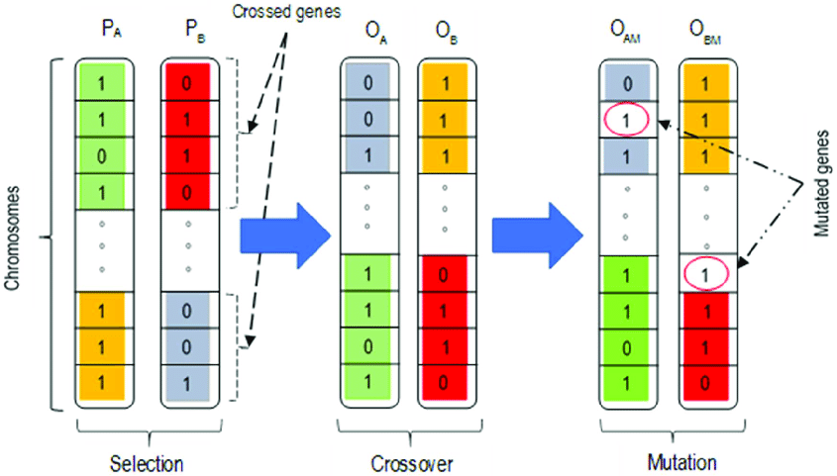
Genetic Algorithm (GA)
Chinedu I. Ossai, Prognosis and Remaining Useful Life Estimation of Lithium-Ion Battery with Optimal Multi-Level Particle Filter and Genetic Algorithm, Batteries 2018, 4, 15; doi:10.3390/batteries4020015
Notes:
The crossover step randomly selects two members of the remaining population (the fittest chromosomes) and exchanges and mates them.
The final step of GA is mutation. In this step, the mutation operator randomly mutates on a gene of a chromosome. Mutation is a crucial step in GA since it ensures that every region of the problem space can be reached.
Elitism is used to prevent the best solution of the population from being destroyed during crossover and mutation operation. Elitism guarantees the fitness of new generation will be at least as good as current generation.
The evaluation and generation of the new populations continue until the maximum number of generations is reached or the optimum solution is found.

Slide 11
Genetic Algorithm (GA)
GA is advantageous in terms of requiring limited parameter settings and initializing itself from possible solutions rather than a single solution.
One of the main drawbacks of GA is the lack of fast convergence towards the optimal values since the crossover and mutation process are random [6, 7].
The applications of GA are wide ranging from scheduling [8, 9], machine learning [10], robotics [11, 12], signal processing [13], business [14], mathematics [15], manufacturing [16, 17], routing [18], and many more.

Slide 12
Ways to modify GA Crossover & Mutation
In crossover, instead of selecting one crossover point, De Jong et al. (1992) and Üçoluk (2002) have introduced N-point crossover and segmented crossover which selects several points for crossover [19, 20]. The difference between them is N-point crossover is choosing several breaking points randomly, while in segmented crossover, only two breaking points are utilized.
Several studies have given different methods for mutation. By default, each gene in a chromosome is assigned with probability, pm, and mutated depending on that probability. This mutation is known as uniform mutation. The other approaches for mutation are bitwise inversion where the whole gene in a chromosome is mutated using a random mutation [19].
Notes:
Since the introduction of GA, many researchers have conducted studies to improve the performance of the GA.
They have introduced several alternative approaches for crossover and mutation to enhance the quality of solutions.
Mutation is one of the most important operators in GA in order to direct the chromosomes towards the better solution.

Slide 13
Ways to modify GA Crossover & Mutation
Adaptive genetic algorithms have been introduced in order to allow the use of precise parameters in setting the population size, the crossing over probability, and the mutation probability. All of these parameters are dynamic and changing over the iterations.
Reinitialization: Raja and Bhaskaran [22] have utilized initialization twice where the first initialization is uses to identify the promising area. After the first initialization, all chromosome are ranked and the best chromosomes are selected. After that, GA is initialize again within the area where the best chromosomes have been identified.
Notes:
For instance, if the population is not improving, the mutation rate is increasing and whenever the population is improving, the mutation rate starts decreasing [21].

Slide 14
Particle Swarm Optimization
PSO is an Evolutionary Algorithm inspired from animal social behaviors. (Kennedy, 1995, Ribeiro and Schlansker, 2005; Chang et al., 2004; Pugh and Martinoli, 2006; Sousa et al., 2003; Nomura,2007)
PSO outperformed other Evolutionary Algorithms such as GA in some problems (Vesterstrom and Riget, 2002; Ratnaweera et al., 2004; Pasupuleti and Battiti,2006).
PSO is an optimization technique which models a set of potential problem solutions as a swarm of particles moving about in a virtual search space. (Kennedy, 1995 )

Slide 15
Particle Swarm Optimization
The method was inspired by the movement of flocking birds and their interactions with their neighbors in the group. (Kennedy, 1995 )
PSO achieves optimization using three primary principles: (Pugh, Martinoli, 2007)
Evaluation, where quantitative fitness can be determined for some particle location;
Comparison, where the best performer out of multiple particles can be selected;
Imitation, where the qualities of better particles are mimicked by others.

Slide 16
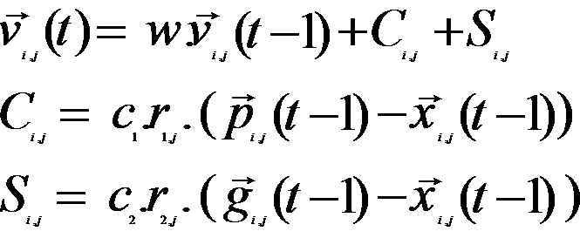
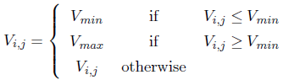
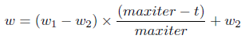
Particle Swarm Optimization
Velocity: (1)
Maximum Velocity (2)
Inertia Weight (2-1)

Slide 17
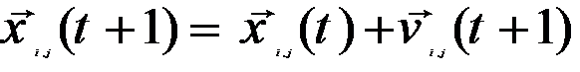
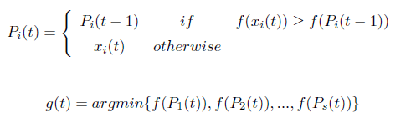
Particle Swarm Optimization
Solutions (positions): (3)
Personal best and Global Best (4)

Slide 18
Problems and Solutions in Basic PSO
Problems
Premature convergence
Parameter control
Diversity (exploration, exploitation)
Dynamic domains
Real Time domains
Solutions
Improvement on neighborhood topology, velocity equation, global best and personal best.
Niching PSO, Mutation, Parallelism, Reinitialization, Clearing memory, Using Sub-Swarms
(Brits, Engelbrecht, and Van Den Bergh, 2002,2003; Yoshida, et al.,2001; Stacey, Jancic and Grundy,2003;Chang, et al., 2005; Vestestrom, Riget, 2002; Qin et al., 2004; Pasupuleti and Battiti, 2006; Ratnaweera et al., 2004;Peram et al., 2003; Parsopoulos and Vrahatis, 2002)

Slide 19
Various Modeling of PSO
Two main implementation of PSO are known as i) Macroscopic and ii) Microscopic models.
Microscopic Modeling: refer to implementations in which each agent represent a swarm by itself and particles of that swarm, represent the possible acts for that individual agent as the next move.
Macroscopic Modeling: refer to implementations in which each agent represent a particle of the swarm therefore, the whole team represent the swarm.
(Agassounon et al., 2004, Chang et al., 2005, Kazadi et al., 2002, Lerman et al., 2001, Martinoli et al., 2007, Pugh and Martinoli 2007a, Li et al., 2004)

Slide 20
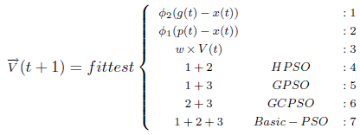
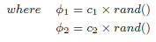
Modifying PSO formulation

Slide 21
Performance Comparison: Benchmark Problems
There are many optimization techniques claiming superiority over other approaches.
In order to determine the most reliable algorithms, benchmark functions can be used as indicator to prove their effectiveness.
Several benchmark functions with different properties have been used to evaluate the feasibility of optimization algorithms;

Slide 22
Performance Comparison: Benchmark Problems
There are 3 properties that are considered in benchmark functions called multimodality, separability, and regularity.
A function is multimodal if it has two or more local optima.
A function of p variables is separable if it can be rewritten as a sum of p functions of just one variable. The separability is closely related to the concept of epistasis or interrelation among the variables of the function. In the field of evolutionary computation, the epistasis measures how much the contribution of a gene to the fitness of the individual depends on the values of other genes.

Slide 23
Performance Comparison: Benchmark Problems
Non separable functions are more difficult to optimize as the accurate search direction depends on two or more genes. On the other hand, separable functions can be optimized for each variable in turn. The problem is even more difficult if the function is also multimodal. The search process must be able to avoid the regions around local minima in order to approximate, as far as possible, the global optimum. The most complex case appears when the local optima are randomly distributed in the search space.
The dimensionality of the search space is another important factor in the complexity of the problem. A study of the dimensionality problem and its features was carried out by Friedman [Fri94].

Slide 24
Performance Comparison: Parameter settings
GA:
Max iteration numbers is set to 100
Population sizes is set to 100
Single point crossover type is used with 1 crossover probability.
Mutation probability is set to 0.01
the best two solutions are selected for elitism.
PSO:
Max iteration numbers is set to 100
Population sizes is set to 100
Inertia weight value used is 0.728994
acceleration coefficients (c1,c2) for cognitive and social are set to 0.5 and 2.5 respectively.
Notes:
Single-point crossover[edit]
A point on both parents' chromosomes is picked randomly, and designated a 'crossover point'. Bits to the right of that point are swapped between the two parent chromosomes. This results in two offspring, each carrying some genetic information from both parents.
1) randomly selects two individuals
2) draw a number between 0-1
3) If the number <= crossover probability than
you draw o point of crossing and replacing genes
else
leave individuals without change
end

Slide 25
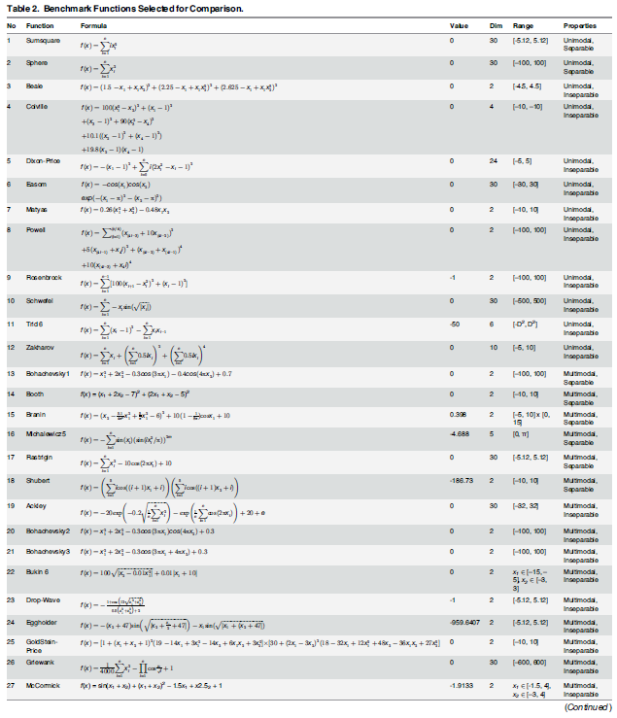
Performance Comparison: Benchmark Problems
Ab Wahab MN, Nefti-Meziani S, Atyabi A (2015) A Comprehensive Review of Swarm Optimization Algorithms. PLoS ONE 10(5):e0122827. doi:10.1371/journal.pone.0122827

Slide 26
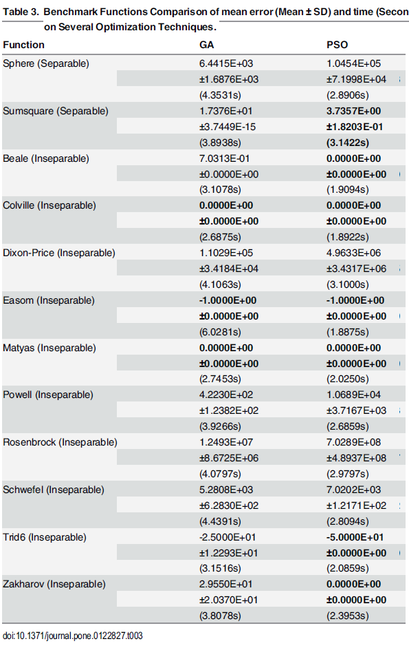
Performance Comparison
Ab Wahab MN, Nefti-Meziani S, Atyabi A (2015) A Comprehensive Review of Swarm Optimization Algorithms. PLoS ONE 10(5):e0122827. doi:10.1371/journal.pone.0122827

Slide 27
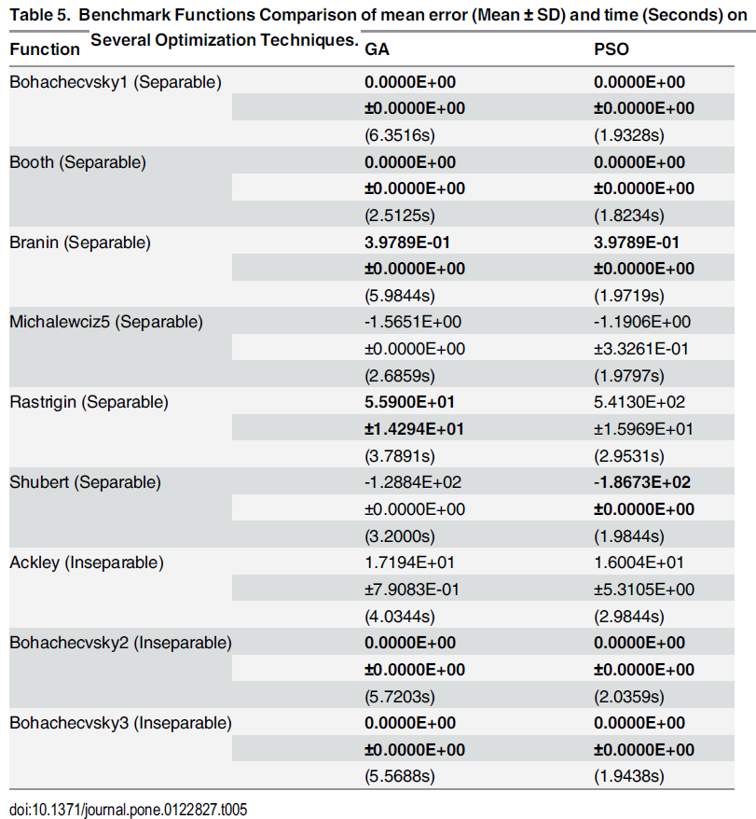
Performance Comparison
Ab Wahab MN, Nefti-Meziani S, Atyabi A (2015) A Comprehensive Review of Swarm Optimization Algorithms. PLoS ONE 10(5):e0122827. doi:10.1371/journal.pone.0122827

Slide 28
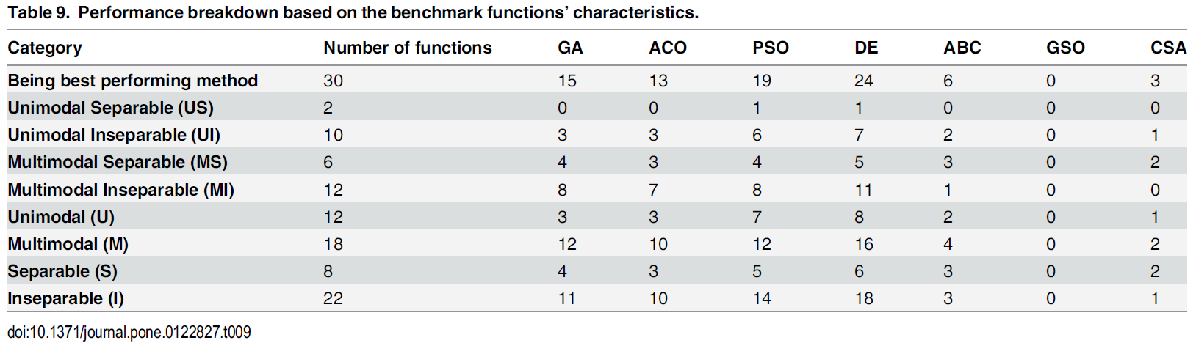
Performance Comparison: Overall Results on 30 benchmark functions
Ab Wahab MN, Nefti-Meziani S, Atyabi A (2015) A Comprehensive Review of Swarm Optimization Algorithms. PLoS ONE 10(5):e0122827. doi:10.1371/journal.pone.0122827
Notes:
Genetic Algorithm
Ant Colony Optimization
Particle Swarm Optimization Differential Evolution
Artificial Bee Colony
Glowworm Swarm Optimization
Cuckoo Search Algorithm

Slide 29
Things to consider when deciding on
which evolutionary method to use
Based on performance with benchmark functions, PSO and DE are known to be the most effective optimization techniques.
PSO is known to be flexible in its design and when combined with macroscopic and microscopic modeling, it has the ability to fit the problem at hand.
How to model the evolutionary method is highly effected by the user’s experience. An ill modeled EA method can be computationally intensive, memory intensive, and achieve lower than expected performance.

Slide 30
Lecture 9: Search Optimization- Part II Simulated Annealing, Tabu Search & Ant Colony Optimization
CS-4820/5820
Tu/Th 12:15 PM-1:30 PM
Room: Centennial Hall 106
Instructor: Adham Atyabi
Office: Engineering 243
Office Hours: Mon 9:00 AM-14:00 PM.
Email: aatyabi@uccs.edu
Teaching Assistant: Ali Al Shami (aalshami@uccs.edu)

Slide 31
Disclosure
We are using materials from Prof. Panagiotis Repoussis’s lecture on metaheuristic algorithms in Stevens Institute of Technology
We are also using Prof. Jugal Kalita’s materials and lecture slides on Ant Colony Optimization

Slide 32
References
Talbi E.-G., 2009. Metaheuristics: from design to implementation, Vol. 74, John Wiley & Sons
Blum C. and Roli A., 2003. Metaheuristics in combinatorial optimization: Overview and conceptual comparison, ACM Computing Surveys, 35(3):268-308
Back T., Hammel U. and Schwefel H.-P., 2002. Evolutionary computation: comments on the history and current state, IEEE Transactions on Evolutionary Computation, 1(1):3-17

Slide 33
Introduction
Heuristics
“to find” (from ancient Greek “ευρίσκειν”)
Meta-
An abstraction from another concept
beyond, in an upper level
used to complete or add to
E.g., meta-data = “data about data”
Metaheuristics
“A heuristic around heuristics”

Slide 34
Introduction
Some popular frameworks
Genetic Algorithms
Simulated Annealing
Tabu Search
Scatter Search
Ant Colony Optimization
Particle Swarm Optimization
Iterated Local Search
Variable Neighborhood Search
Adaptive Memory Programming
…

Slide 35
Introduction
Metaheuristics…
…can address both discrete- and continuous-domain optimization problems
…are strategies that “guide” the search process
…range from simple local search procedures to complex adaptive learning processes

Slide 36
Introduction
Metaheuristics…
…efficiently explore the search space in order to find good (near-optimal) feasible solutions
…provide no guarantee of global or local optimality
…are agnostic to the unexplored feasible space (i.e., no “bound” information)
…lack a metric of “goodness” of solution (often stop due to an external time or iteration limit)
…are not based on some algebraic model
unlike exact methods!
…are often used in conjunction with an exact method
E.g., use metaheuristic to provide upper bounds
E.g., use restricted MILP as “local heuristic”

Slide 37
Introduction
Metaheuristics…
…usually are non-deterministic
…usually incorporate mechanisms to avoid getting trapped in confined areas of the search space
…are not problem specific (but their subordinate heuristics are)
…may use some form of memory to better guide the search

Slide 38
Introduction
Metaheuristics…
…is a relatively new field (started in the ‘80s or so)
becomes possible because we can now afford vast amounts of computation
inspired from “AI,” rather than “pure math”
lack of theoretical “rigor” (no proofs, theorems, etc. for people to pursue)

Slide 39
Introduction
Let’s consider the problem of find the best visiting sequence (route) to serve 14 customers.
How many possible routes exists?
(n-1)!=(15-1)!=14!= 8,7178 X 1010 = 88 billion solutions
If a PC can check about 1 million solution per second, then we need 8,8*1010 routes /106 routes/ sec = 88.000 sec or about 24,44 hours to check them all and find the best!

Slide 40
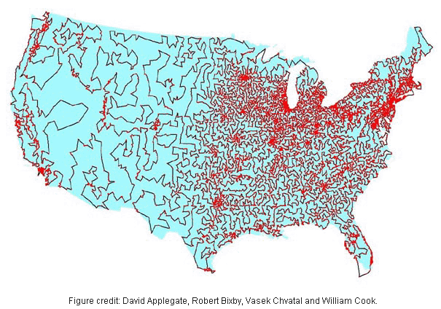
COMBINATORIAL EXPLOSION
13,509-city TSP
19,982.859 mi.
What type of algorithm would you pick to solve a problem with 10^{49,933} feasible solutions?

Slide 41
Two basic defenitions
A neighborhood C$(s)$ around a solution $s$ is a function that returns a subset of solutions that are somehow close or related to $s$
implies a “direction of search”
multiple neighborhoods can be defined for a solution $s$
could be exhaustive or not (if not, it could actually be random)
A move $s⟵s′$ constitutes a choice of a solution $s′∈C(s)$

Slide 42
CLASSIFICATION
Based on whether the search evolves one or multiple solutions
Trend towards population-based methods, with integration of proven ideas from trajectory methods
(single) Trajectory methods
Tabu Search
Population-based methods
Genetic Algorithms
Ant Colony Optimization
Iterated Local Search
Simulated Annealing
Adaptive Memory Programming

Slide 43
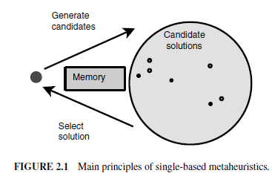
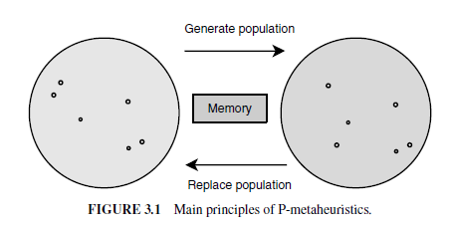
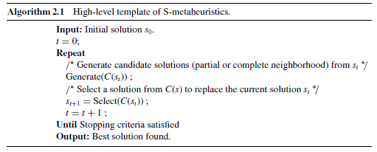
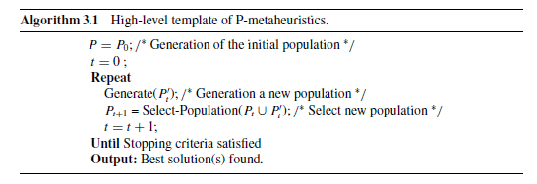
CLASSIFICATION #5
Trajectory
(S-metaheuristics)
Population-based
(P-metaheuristics)

Slide 44
TRAJECTORY METHODS

Slide 45
TRAJECTORY METHODS
C(s₀)
s₀

Slide 46
TRAJECTORY METHODS
C(s₀)
s₀
s₁
C(s₁)

Slide 47
TRAJECTORY METHODS
C(s₀)
s₀
s₁
C(s₁)
s₂
C(s₂)
Stop because of no improvement in region C(s₂)

Slide 48
TRAJECTORY METHODS
C(s₀)
s₀
s₁
C(s₁)
s₂
C(s₂)
Turns out two global optima in this problem, but none was identified
One was missed during search of region C(s₁)
One was far away from searched space

Slide 49
POPULATION-BASED METHODS

Slide 50
POPULATION-BASED METHODS
0th population

Slide 51
POPULATION-BASED METHODS
Get some new points

Slide 52
POPULATION-BASED METHODS
Drop some old points

Slide 53
POPULATION-BASED METHODS
1st population

Slide 54
POPULATION-BASED METHODS
2nd population

Slide 55
POPULATION-BASED METHODS
All points sampled
Again, optimum may or may not have been sampled
Typically, the incumbent always remains in the population, so need only focus on last generation

Slide 56
CLASSIFICATION #5
Trajectory
(S-metaheuristics)
Basic Local Search (3192 BC)
Simulated Annealing (1983)
Tabu Search (1986)
GRASP (1989)
Guided Local Search (1997)
Variable Neighborhood Search (1999)
Iterated Local Search (1999)

Slide 57
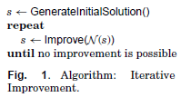
BASIC LOCAL SEARCH
Neighborhood
Improve() can be implemented as “first improvement” or “best improvement” or anything in between

Slide 58
BASIC LOCAL SEARCH
Neighborhood

Slide 59
BASIC LOCAL SEARCH
Neighborhood
Local optimum found, cannot improve!
How to escape the local optimum “trap”?

Slide 60
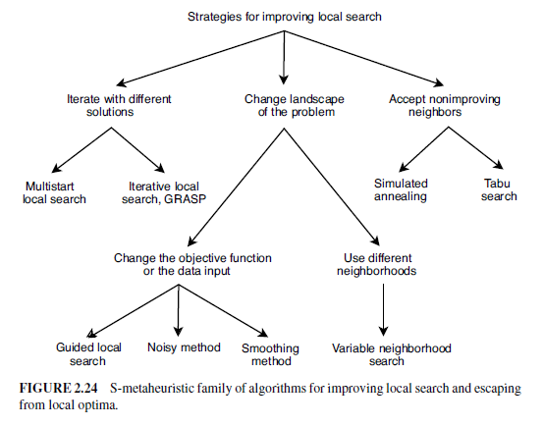
ESCAPING LOCAL OPTIMA

Slide 61
INTENSIFY & DIVERSIFY
Merriam-Webster:
Intensify
to become stronger or more extreme; to become more intense
Diversify
to change (something) so that it has more different kinds of people or things

Slide 62
INTENSIFY & DIVERSIFY
Every metaheuristic aspires to do both
Many have parameters to control this balance
Often, these parameters can be changed dynamically during search
Initially, focus is on diversification; later, on intensification (and cycles back)

Slide 63
INTENSIFY & DIVERSIFY

Slide 64
INTENSIFY & DIVERSIFY

Slide 65
TABU SEARCH
Taboo (English): prohibited, disallowed, forbidden
Tabu (Fijian): forbidden to use due to being sacred and/or of supernatural powers
…related to similar Polynesian words
tapu (Tongan), tapu (Maori), kapu (Hawaiian)

Slide 66
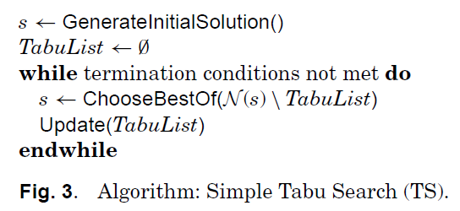
TABU SEARCH
Used mainly for discrete problems
The tabu list constitutes “short-term memory”
Size of tabu list (“tenure”) is finite
Since solutions in tabu list are off-limits, it helps
escape local minima by forcing uphill moves (if no improving move available)
avoid cycling (up to the period induced by tabu list size)
Solutions enter and leave the list in a FIFO order (usually)

Slide 67
TABU SEARCH
Small tenure localizes search (intensification)
Large tenure forces exploration of wider space (diversification)
Tenure can change dynamically during search
Size of tenure is a form of “long-term memory”

Slide 68
TABU SEARCH
Storing complete solutions is inefficient
implementation perspective (storage, comparisons)
algorithm perspective (largely similar solutions offer no interesting information)
Tabu search usually stores “solution attributes”
solution components or solution differences (“moves”)

Slide 69
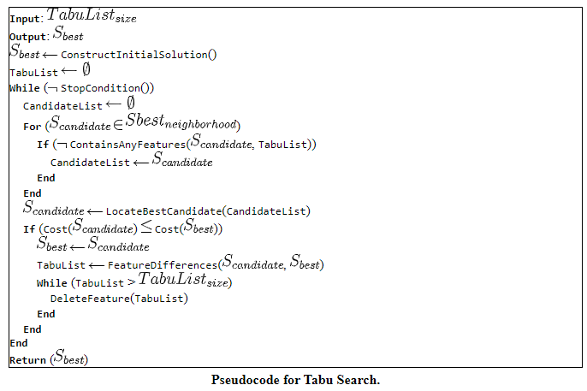
http://www.cleveralgorithms.com/nature-inspired/stochastic/tabu_search.html#targetText=Tabu%20Search%20is%20a%20Global,Search%20and%20Parallel%20Tabu%20Search.
Notes:
The objective for the Tabu Search algorithm is to constrain an embedded heuristic from returning to recently visited areas of the search space, referred to as cycling. The strategy of the approach is to maintain a short term memory of the specific changes of recent moves within the search space and preventing future moves from undoing those changes. Additional intermediate-term memory structures may be introduced to bias moves toward promising areas of the search space, as well as longer-term memory structures that promote a general diversity in the search across the search space.
This Algorithm provides a pseudocode listing of the Tabu Search algorithm for minimizing a cost function. The listing shows the simple Tabu Search algorithm with short term memory, without intermediate and long term memory management.

Slide 70
TABU SEARCH
Asymmetric TSP
Tabu List
(tenure = 3)
Solution Trajectory
A
1
B
A | B | C | D | A
5.5
0.5
2
5
1
1
1.5
D
C
1.5
solution = {tour}
move = {swap consecutive pair}
attributes = {moves}

Slide 71
TABU SEARCH
Asymmetric TSP
Tabu List
(tenure = 3)
Solution Trajectory
A
1
B
A | B | C | D | A
5.5
0.5
2
5
1
1
1.5
D
C
AB
B | A | C | D | B
5.0
1.5
BC
A | C | B | D | A
9.5
solution = {tour}
CD
A | B | D | C | A
4.0
move = {swap consecutive pair}
DA
D | B | C | A | D
4.5
attributes = {moves}

Slide 72
TABU SEARCH
Asymmetric TSP
Tabu List
(tenure = 3)
Solution Trajectory
A
1
B
A | B | C | D | A
5.5
0.5
A | B | D | C | A
4.0
2
5
1
1
1.5
D
C
1.5
AB
B | A | C | D | B
5.0
BC
A | C | B | D | A
9.5
solution = {tour}
CD
A | B | D | C | A
4.0
move = {swap consecutive pair}
attributes = {moves}
DA
D | B | C | A | D
4.5

Slide 73
TABU SEARCH
Asymmetric TSP
Tabu List
(tenure = 3)
Solution Trajectory
A
1
B
A | B | C | D | A
5.5
CD
0.5
A | B | D | C | A
4.0
2
5
1
1
1.5
D
C
1.5
solution = {tour}
move = {swap consecutive pair}
attributes = {moves}

Slide 74
TABU SEARCH
Asymmetric TSP
Tabu List
(tenure = 3)
Solution Trajectory
A
1
B
A | B | C | D | A
5.5
CD
0.5
A | B | D | C | A
4.0
2
5
1
1
1.5
D
C
AB
B | A | D | C | A
5.0
1.5
BD
A | D | B | C | A
4.5
DC
A | B | C | D | A
5.5
solution = {tour}
move = {swap consecutive pair}
CA
C | B | D | A | C
9.5
attributes = {moves}

Slide 75
TABU SEARCH
Asymmetric TSP
Tabu List
(tenure = 3)
Solution Trajectory
A
1
B
A | B | C | D | A
5.5
BD
CD
0.5
A | B | D | C | A
4.0
2
5
1
A | D | B | C | A
4.5
1
1.5
D
C
1.5
AB
B | A | D | C | A
5.0
BD
A | D | B | C | A
4.5
solution = {tour}
DC
A | B | C | D | A
5.5
move = {swap consecutive pair}
attributes = {moves}
CA
C | B | D | A | C
9.5

Slide 76
TABU SEARCH
Asymmetric TSP
Tabu List
(tenure = 3)
Solution Trajectory
A
1
B
A | B | C | D | A
5.5
BD
CD
0.5
A | B | D | C | A
4.0
2
5
1
A | D | B | C | A
4.5
1
1.5
D
C
1.5
AD
D | A | B | C | D
5.5
DB
A | B | D | C | A
4.0
solution = {tour}
BC
A | D | C | B | A
9.5
move = {swap consecutive pair}
attributes = {moves}
CA
C | D | B | A | C
5.0

Slide 77
TABU SEARCH
Asymmetric TSP
Tabu List
(tenure = 3)
Solution Trajectory
A
1
B
A | B | C | D | A
5.5
BD
CD
0.5
A | B | D | C | A
4.0
2
5
1
A | D | B | C | A
4.5
1
1.5
D
C
1.5
AD
D | A | B | C | D
5.5
DB
A | B | D | C | A
4.0
solution = {tour}
BC
A | D | C | B | A
9.5
move = {swap consecutive pair}
attributes = {moves}
CA
C | D | B | A | C
5.0

Slide 78
TABU SEARCH
Asymmetric TSP
Tabu List
(tenure = 3)
Solution Trajectory
A
1
B
A | B | C | D | A
5.5
CA
BD
CD
0.5
A | B | D | C | A
4.0
2
5
1
A | D | B | C | A
4.5
1
1.5
C | D | B | A | C
D
C
5.0
1.5
CD
D | C | B | A | D
9.5
DB
C | B | D | A | C
9.5
solution = {tour}
move = {swap consecutive pair}
BA
C | D | A | B | C
5.5
attributes = {moves}
AC
A | D | B | C | A
4.5

Slide 79
TABU SEARCH
Asymmetric TSP
Tabu List
(tenure = 3)
Solution Trajectory
A
1
B
A | B | C | D | A
5.5
CA
BD
CD
0.5
A | B | D | C | A
4.0
2
5
1
A | D | B | C | A
4.5
1
1.5
C | D | B | A | C
D
C
5.0
1.5
CD
D | C | B | A | D
9.5
solution = {tour}
DB
C | B | D | A | C
9.5
move = {swap consecutive pair}
BA
C | D | A | B | C
5.5
attributes = {moves}
AC
A | D | B | C | A
4.5

Slide 80
TABU SEARCH
Solution Trajectory
A | B | C | D | A
5.5
Asymmetric TSP
Tabu List
(tenure = 3)
A | B | D | C | A
4.0
A
1
B
BA
CA
BD
A | D | B | C | A
4.5
0.5
C | D | B | A | C
5.0
2
5
1
1
C | D | A | B | C
5.5
1.5
D
C
1.5
CD
D | C | A | B | D
4.0
DA
C | A | D | B | C
4.5
solution = {tour}
AB
C | D | B | A | C
5.0
move = {swap consecutive pair}
attributes = {moves}
BC
B | D | A | C | B
9.5

Slide 81
TABU SEARCH
Asymmetric TSP
Tabu List
(tenure = 3)
Solution Trajectory
A
2
B
A | B | C | D | A
11
1
4
10
2
2
NEW DATA!
3
D
C
3
What could happen if tenure were 2 instead of 3?
solution = {tour}
move = {swap consecutive pair}
What could happen if tenure were 4 instead of 3?
attributes = {moves}

Slide 82
TABU SEARCH
Asymmetric TSP
Tabu List
(tenure = 2)
Solution Trajectory
A
1
B
A | B | C | D | A
5.5
0.5
2
5
1
1
1.5
D
C
1.5
What could happen if tenure were 2 instead of 3?

Slide 83
TABU SEARCH
Asymmetric TSP
Tabu List
(tenure = 4)
Solution Trajectory
A
1
B
A | B | C | D | A
5.5
0.5
2
5
1
1
1.5
D
C
1.5
What could happen if tenure were 4 instead of 3?

Slide 84
TABU SEARCH
Decreasing tenure provides for intensification, though encourages cycling
Increasing tenure provides for diversification by encouraging uphill moves
How would you design a good TS algorithm?

Slide 85
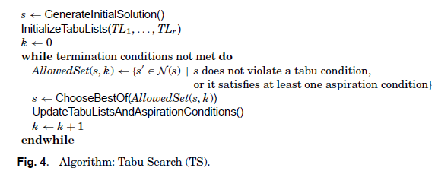
TABU SEARCH
Forbidding “attributes” may be overly restrictive
aspiration conditions are introduced as “wild-cards” for certain solutions, e.g., new incumbents are always accepted, even if they possess taboo attributes

Slide 86

Ant Based Algorithms
Presentation based on Dorigo et al. 1996: Ant System: Optimization by a Colony of Cooperating Agents.

Slide 87
Swarm Intelligence
Collective system capable of accomplishing difficult tasks in dynamic and varied environments without any external guidance or control and with no central coordination
Each agent is simple, but they can be numerous and together achieve difficult tasks.
Achieving a collective performance which could not normally be achieved by an individual acting alone
Constituting a natural model particularly suited to distributed problem solving

Slide 88
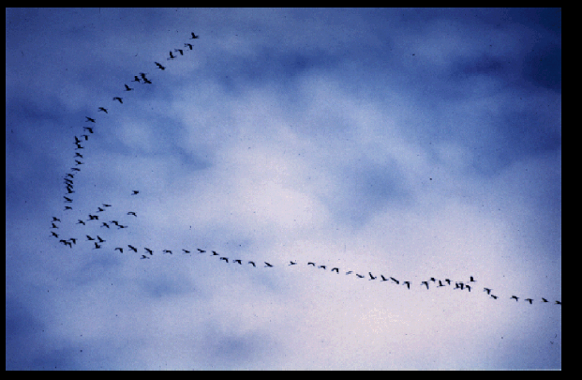
http://www.scs.carleton.ca/~arpwhite/courses/95590Y/notes/SI%20Lecture%203.pdf

Slide 89
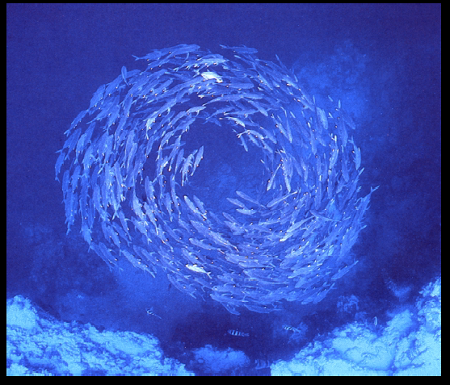
http://www.scs.carleton.ca/~arpwhite/courses/95590Y/notes/SI%20Lecture%203.pdf

Slide 90
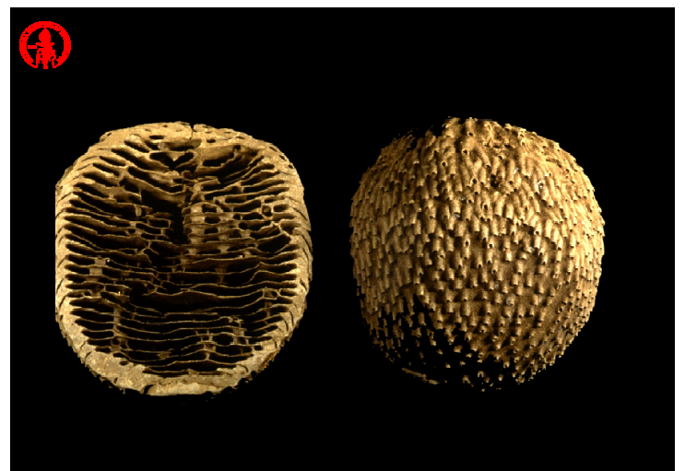
http://www.scs.carleton.ca/~arpwhite/courses/95590Y/notes/SI%20Lecture%203.pdf

Slide 91
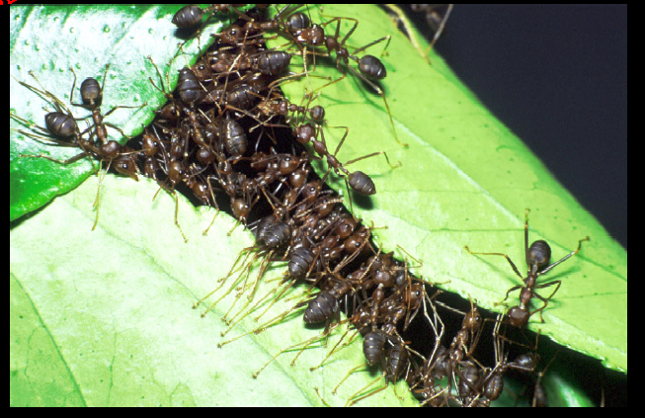
http://www.scs.carleton.ca/~arpwhite/courses/95590Y/notes/SI%20Lecture%203.pdf

Slide 92
Some interesting video links to watch
Many search algorithms have been inspired by nature or real physical processes. Look at the following videos to get a feel for the physical processes. It will help you understand the algorithms better.
Cross-over: https://www.youtube.com/watch?v=4YfDq8rPDdM
Mutations: Mutations are normally considered harmful, but organisms also change for better because of mutation and speciation happens due to mutation as well: https://www.youtube.com/watch?v=efstlgoynlk

Slide 93
REAL ANT BEHAVIOR

Slide 94
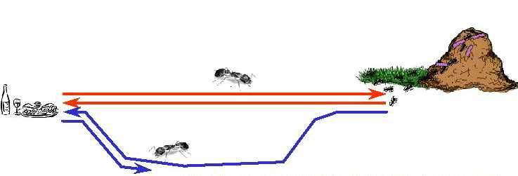
REAL ANT BEHAVIOR
Natural behavior of ants have inspired scientists to mimic insect operational methods to solve real-life complex problems
By observing ant behavior, scientists have begun to understand their means of communication
Ant-based behavioral patterns to address combinatorial problems - first proposed by Dorigo
Ants secrete pheromone while traveling from the nest to food, and vice versa in order to communicate with one another to find the shortest path

Slide 95
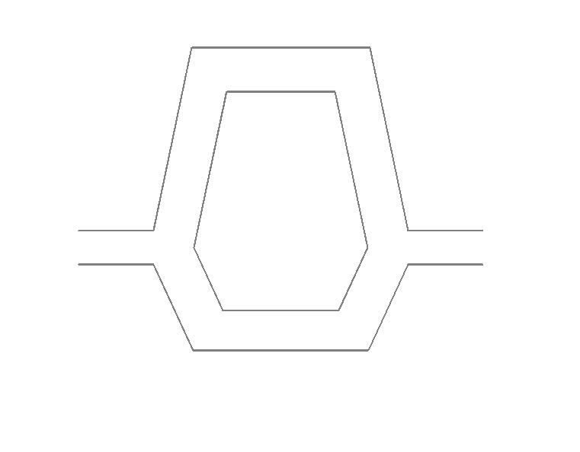
EXPERIMENTAL STUDY OF ANTS
The more ants follow a trail, the more attractive that trail becomes for being followed
NEST
NEST
NEST
FOOD
FOOD
FOOD

Slide 96
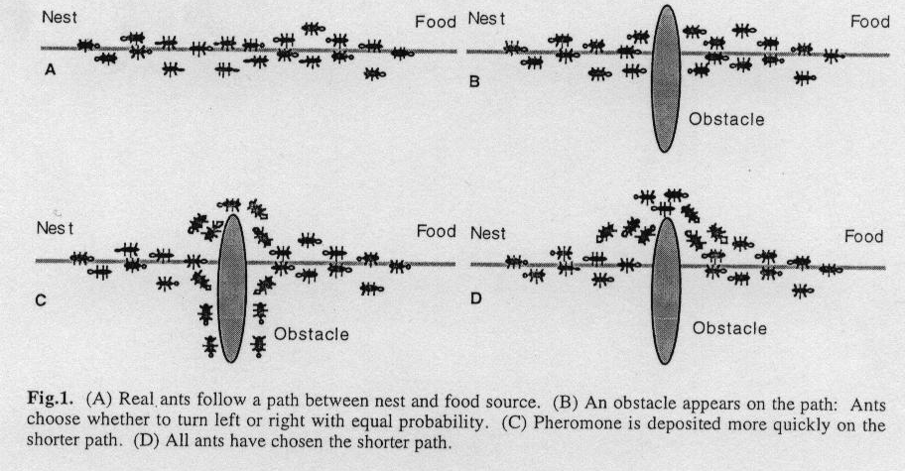
ANT Behavior
The more ants follow a trail, the more attractive that trail becomes for being followed

Slide 97
ROUTE SELECTION
Initially, ants are forced to decide whether they should go left or right, and the choice that is made is a random decision
Pheromone accumulation is faster on the shorter path
The difference in pheromone content between the two paths over time makes the ants choose the shorter path
Positive feedback mechanism to arrive at the shortest route while foraging
Stygmergy or stigmergetic model of communication: indirect communication among agents to perform actions
Different optimization problems have been explored using a simulation of this real ant behavior

Slide 98
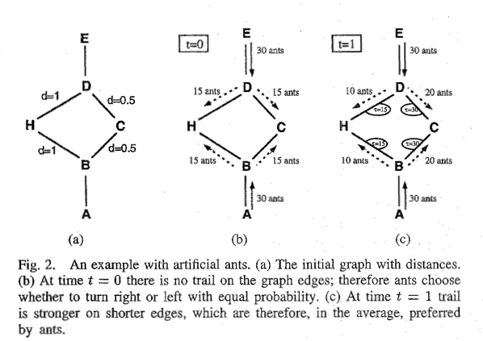
An Simple Made-up Example
The distances are shown as d=number.
Assume 30 ants come from A to B at time t=0; also 30 ants come form E to D. The ants move at at a speed of 1 unit per unit of time.

Slide 99
TRAVELING SALESMAN PROBLEM

Slide 100
PROBLEM DEFINITION
OBJECTIVE
Given a set of n cities, the Traveling Salesman Problem requires a salesman to find the shortest route between the given cities and return to the starting city, while keeping in mind that each city can be visited only once.
The idea is to show that an Ant System can be used to solve the TSP problem first, and then that it can be used to solve other complex problems.

Slide 101
TSP Heuristics
Variety of heuristics used to solve the TSP
The TSP is not only theoretically difficult it is also difficult in practical application since the tour breaking constraints get quite numerous
As a result there have been a variety of methods proposed for the TSP
Nearest Neighbor is a typical greedy approach

Slide 102
Animations of Ant Algorithms
https://www.youtube.com/watch?v=eVKAIufSrHs
https://www.youtube.com/watch?v=8WjUVEamGKA

Slide 103
THE ANT COLONY OPTIMIZATION METAHEURISTIC
A metaheuristic is a higher-level procedure or heuristic designed to find, generate, or select a lower-level procedure or heuristic (partial search algorithm) that may provide a sufficiently good solution to an optimization problem, especially with incomplete or imperfect information or limited computation capacity (Wikipedia).

Slide 104
GOAL OF ACO HEURISTIC
Artificial ants form a multi-agent system performing the functions as observed in the real ant system
Exploit stigmergistic communication
The ACO meta-heuristic relies on the co-operation of a group of artificial ants to obtain a good solution to a discrete optimization problem such as the TSP
The resulting shortest route mapping determined by the agents can be applied to the optimization problem

Slide 105
ACO CHARACTERISTICS
Exploit a positive feedback mechanism
Demonstrate a distributed computational architecture
Exploit a global data structure that changes dynamically as each ant transverses the route
Involves probabilistic transitions among states or rather between nodes

Slide 106
Lecture 9: Search Optimization- Part III Ant Colony Optimization & differential Evaluation
CS-4820/5820
Tu/Th 12:15 PM-1:30 PM
Room: Centennial Hall 106
Instructor: Adham Atyabi
Office: Engineering 243
Office Hours: Mon 9:00 AM-14:00 PM.
Email: aatyabi@uccs.edu
Teaching Assistant: Ali Al Shami (aalshami@uccs.edu)

Slide 107
Disclosure
We are using materials from Prof. Panagiotis Repoussis’s lecture on metaheuristic algorithms in Stevens Institute of Technology
We are also using Prof. Jugal Kalita’s materials and lecture slides on Ant Colony Optimization

Slide 108
FLOWCHART OF ACO
START ACO
Locate m ants randomly
in m cities and store the
current city
in a list for each ant
Have the
maximum
Iterations been
performed
NO
YES
STOP
ACO
For each ant, determine
probabilistically
which city to visit next
NO
Determine the shortest
tour till now and
update pheromone
Have all
cities been visited
by an ant? Have
all ants completed
a tour?
Move each ant to next city
and
place this city in its
list
YES
Record the lengths of
tours and clear list
for each ant

Slide 109
KEY PARAMETERS
Trail intensity is given by value of τ_{ij} which indicates the intensity of the pheromone on the trail segment, (ij). This variable will keep track of how attractive a trail (an edge of the graph, or an entire tour) is
Trail visibility is η_{ij} = 1/d_{ij}. An ant can see only so far. It’s almost blind. It can see closer cities better.
The importance of trail intensity and trail visibility are parameterized.
The importance of the intensity in the probabilistic transition is α
The importance of the visibility of the trail segment is β
The pheromone deposited evaporates in time. The trail persistence or evaporation rate is given as ρ
Q is a constant and the amount of pheromone laid on a trail segment by an ant. I.e., how much pheromone does ant place on its tour.

Slide 110
PROBABILISTIC CITY SELECTION
Helps determine the city to visit next while the ant is in a tour
Determined by variables such as the pheromone content on an edge (i,j) at time instant t, heuristic function of the desirability of adding edge, and their control parameters (probability of going from node I to node j at time t for the k_{th} ant) where J_{k} is the tour the kth ant found.

Slide 111
PHEROMONE UPDATING
Let the length of the completed tour for the k-th Ant be L_{k}. The quantity of pheromone per unit of length of the trail that this kth ant adds to each edge belonging to the tour is given by
The pheromone decay, per unit length, in each edge of a tour is given by

Slide 112
Summary of the ALGORITHM
m ants are places on m nodes randomly
Each ant moves from node to node (under constraints that it must build a tour) based on probabilities computed using
Edge attractiveness (how much pheromone)
Edge length (shorter edges are more attractive; greedy approach)
Each of the m ants completes a tour
The shortest of m tours is chosen.
New pheromone is deposited on edges of this most successful tour; some pheromone evaporates.
This process is repeated a large number of times

Slide 113
Animations of Ant Algorithms
https://www.youtube.com/watch?v=eVKAIufSrHs
https://www.youtube.com/watch?v=8WjUVEamGKA

Slide 114
Consider the Case Studies in Papers

Slide 115
Observations
A good number of ants is equal to the number of cities
The initial distribution of the ants among the cities does not really matter
An elitist strategy in which the segments on the best solution(s) is(are) continually reinforced work well so long as there were not too few or too many elitist solutions
Large values of α lead to bad solutions.
Very small values of α also lead to bad solutions
Dorigo found that values of α and β in the range 1 to 5 seem to work. Problem specific.
Dorigo also found that small values of ρ, say 0.5, and values of Q in the range of a few hundred, say Q=100, work.
There are papers on setting these parameters,

Slide 116
APPLICATIONS (from Wikipedia)
Scheduling problem
Job-shop scheduling problem (JSP)
Open-shop scheduling problem (OSP)
Permutation flow shop problem (PFSP)
Single machine total tardiness problem (SMTTP)
Single machine total weighted tardiness problem (SMTWTP)
Resource-constrained project scheduling problem (RCPSP)
Group-shop scheduling problem (GSP)
Single-machine total tardiness problem with sequence dependent setup times (SMTTPDST)
Multistage Flowshop Scheduling Problem (MFSP) with sequence dependent setup/changeover times

Slide 117
APPLICATIONS (from Wikipedia)
Vehicle routing problem
Capacitated vehicle routing problem (CVRP)
Multi-depot vehicle routing problem (MDVRP)
Period vehicle routing problem (PVRP)
Split delivery vehicle routing problem (SDVRP)
Stochastic vehicle routing problem (SVRP)
Vehicle routing problem with pick-up and delivery (VRPPD)
Vehicle routing problem with time windows (VRPTW)
Time Dependent Vehicle Routing Problem with Time Windows (TDVRPTW)
Vehicle Routing Problem with Time Windows and Multiple Service Workers (VRPTWMS)

Slide 118
APPLICATIONS (from Wikipedia)
Assignment problem
Quadratic assignment problem (QAP)
Generalized assignment problem (GAP)
Frequency assignment problem (FAP)
Redundancy allocation problem (RAP)
Set problem[edit]
Set cover problem (SCP)
Partition problem (SPP)
Weight constrained graph tree partition problem (WCGTPP)
Arc-weighted l-cardinality tree problem (AWlCTP)
Multiple knapsack problem (MKP)
Maximum independent set problem (MIS)

Slide 119
APPLICATIONS (from Wikipedia)
Others
Classification
Connection-oriented network routing
Connectionless network routing
Data mining
Discounted cash flows in project scheduling
Distributed Information Retrieval
Grid Workflow Scheduling Problem
Image processing
Intelligent testing system
System identification
Protein Folding
Power Electronic Circuit Design

Slide 120
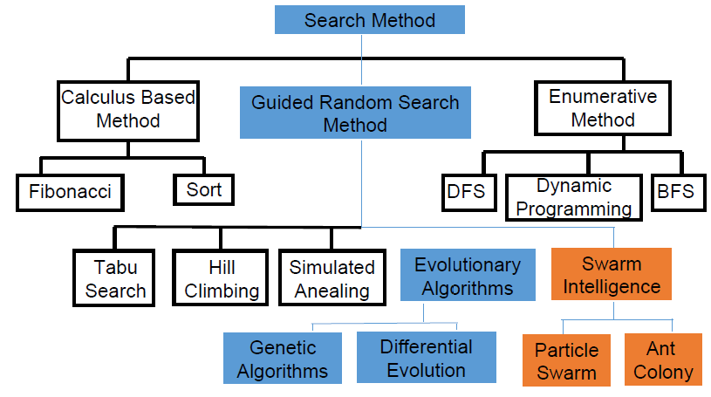
Classes of Search Methods

Slide 121
Differential Evolution
Real Parameter Optimizer
Utilizes a pre-specified number of random solutions
Continuously improves them through a series of mutations and recombinations
Usually, the number of pre-specified solutions i.e. the population size
does not change during the lifetime of the algorithm

Slide 122
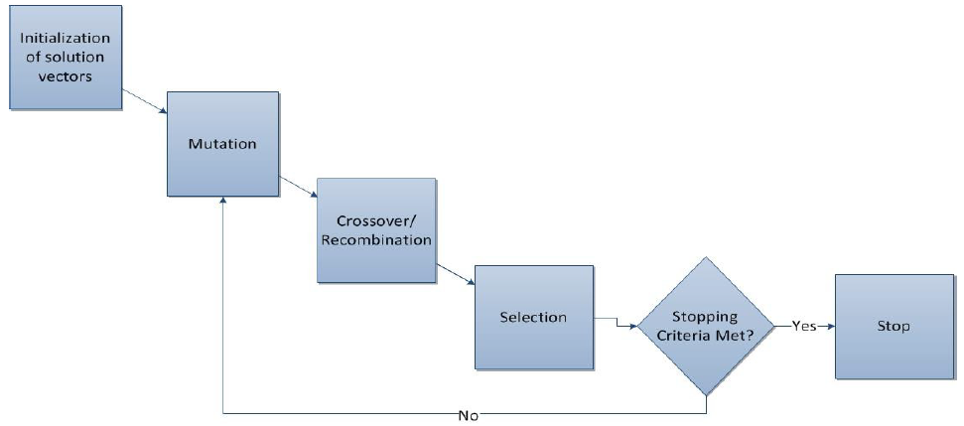
Differential Evolution

Slide 123
Heuristic Methods
Differential Evolution (DE)
Population based algorithm presented by Storn and Price (1995)
Devised to Continuous Search Spaces
DE/rand/1/bin
Initialization of Vectors
Evaluation
(fitness)
Selection
Vector difference (Mutation)
Vector recombination (Crossover)
Notes:
DE starts with steps such as population initialization followed by evaluation to determine the fittest members
of the population. Later, new parameter vectors get generated by adding the weighted difference
of the two population vectors with the third vector. This step is referred to as mutation.
Within the crossover, the vector is mixed and the algorithm takes a final step of selection.

Slide 124
Important Nomenclature
D = Dimensionality of the problem
NP = No. of solution vectors in a population
G = No. of generations the population has to go through
F = Scaling Factor
Cr = Crossover rate

Slide 125
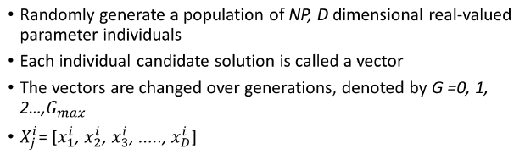
Initialization

Slide 126
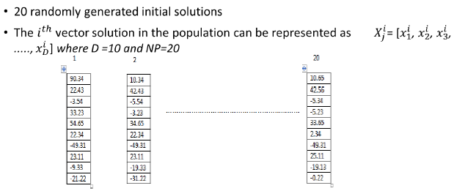
Initial Population

Slide 127
Mutation
Mutation is a change in the gene characteristics of a chromosome.
When applied to evolutionary computation it means a change in the parameters of the vector through a perturbation with a random element.
Notes:
Since this algorithm relies on mutation operation, it utilizes the mutation as a search mechanism and takes advantage of the selection operation in order to direct the search towards the potential regions in the search space.

Slide 128
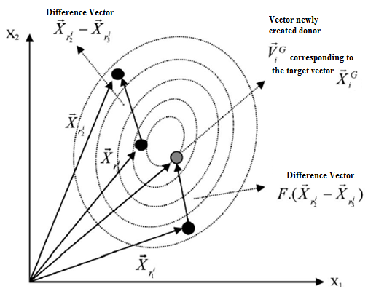
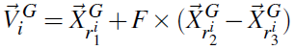
Heuristic Methods
Differential Evolution (DE)
Mutation

Slide 129
Mutation
A parent vector from the current generation is called target vector
The mutant vector obtained through differential perturbation is called donor vector
The offspring obtained through recombination of target and donor is called trial vector
Notes:
Target Vector, Mutant Vector, and Trail Vector are three properties that DE utilizes for generating a new population iteratively.
The target vector is the vector that contains the solution for the search space; the mutant vector is the mutation of the target vector; and the trail vector is the resultant vector after the crossover operation between target vector and mutant vector.

Slide 130
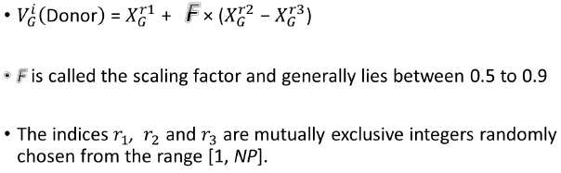
Mutation
Notes:
solution vectors xr1, xr2, and xr3 being chosen randomly

Slide 131
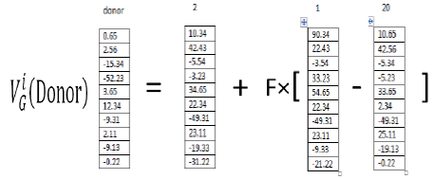
Mutation

Slide 132
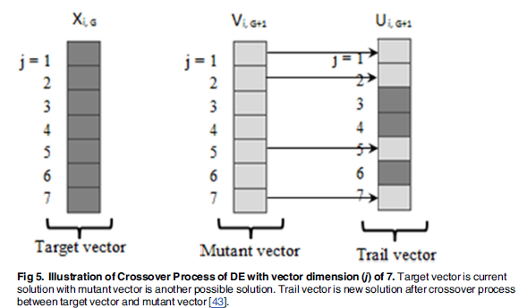
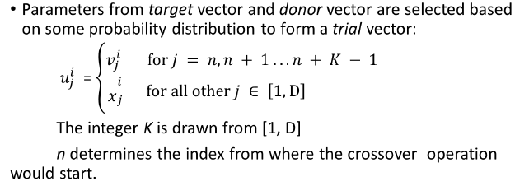
Crossover
Notes:
Crossover operation is introduced to increase the diversity of the disconcerted parameter vectors. The parent vector is mixed with a mutated vector and a trial vector is produced by:
In here vij is Vi,G+1 from fig 5
In DE, all solutions in the population have the same probability of being selected as parents without considering their fitness value. This is the main difference in the operations of DE and GA. Simply put, the child (trail vector) produced is only evaluated after mutation and crossover operations. After that, the performance of this child vector is compared to its parent and the better vector is retained in the population.

Slide 133
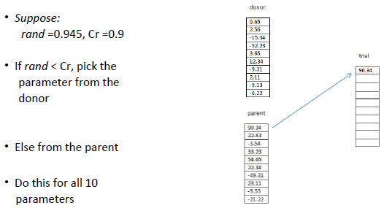
Create Trial Vector

Slide 134
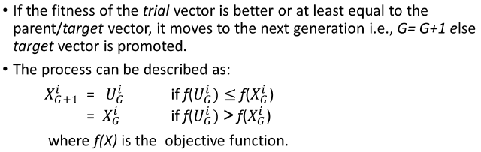
Selection- Choose between Parent and Child/Trial Vector

Slide 135
Control Parameters
NP, F and Cr are collectively termed as control parameters of DE
The performance of DE is very sensitive to the values of control parameters
Every problem/function may respond differently to different sets of control parameters.

Slide 136
Summary of DE
The exploitation behavior occurs when the difference between two solution vectors in are small while the exploration behavior occurs when the difference between those two are large
DE is advantageous in terms of enhancing the capacity of local search and keeping the multiplicity of the population while it suffers from slow convergence and being unstable
Higher population size can benefit DE performance
Using similar mechanism to LDIW in PSO, scaling factor can be tuned to balance exploration and exploitation behaviors by starting with exploration and gradually turn to do more exploitation.
Elitism which can avoid the best solution from being destroyed when the next generation is created

